Slide 1
ROME NOVEMBER 2014
Portal for the Coastline and the sea
The French solution

Slide 2
BACKGROUND
In recent years, an increasing number of countries have initiated marine management processes although a small number of pioneering experiences date back to the 1970s and remain very specific in different contexts.
Australia, United-States, Turkey, New Zealand have launched projects to map coastal portal in 3D in order to identify the uses and regulations and determining the responsible bodies.
What is now acknowledged as an inevitable process has become essential in dealing with the expansion of marine activities in terms of intensity and diversity, and with what appears to be a proportional increase
in pressure on marine environments.

Slide 3
EU initiatives on marine knowledge and management
Marine Strategy Framework Directive (Adopted the 17th of June 2008)
The Marine Directive aims to achieve Good Environmental Status (GES) of the EU's marine waters by 2020 and to protect the resource base upon which marine-related economic and social activities depend. It is the first EU legislative instrument related to the protection of marine biodiversity, as it contains the explicit regulatory objective that "biodiversity is maintained by 2020", as the cornerstone for achieving GES
Communication « Marine Knowledge 2020 », September 2010
Green Paper on seabed mapping, August 2012

Slide 4
EU initiatives on marine knowledge and management
Directive for Maritime Spatial Planning (Adopted the 23th of July 2014)
Why : To help Member States develop plans to better coordinate the various activities that take place at sea, ensuring they are as efficient and sustainable as possible. In coastal and maritime areas, many activities compete for the same space and resources: fishing grounds, aquaculture farms, marine protected areas exist alongside maritime infrastructures such as cables, pipelines, shipping lanes and oil, gas and wind installations. The new Directive will help avoid potential conflicts between such diverse uses and create a stable environment attractive to investors, thereby contributing to sustainable

Slide 5
EU initiatives on marine knowledge and management
The Member States’ role in implementing the directive :
« Member States will be asked to draw up maritime spatial plans, which will map existing human activities and identify their most effective future spatial development at sea, and develop integrated coastal management strategies which will ensure coordinated management of these human activities in coastal areas. They will have to fulfil minimum requirements which are of procedural nature : develop maritime spatial plans and integrated coastal management strategies, and establish appropriate cross-border cooperation among them. To Member States to establish a process or processes that cover the full cycle of problem identification, information
collection, planning, decision-making, management, monitoring
of implementation, and stakeholder participation. »

Slide 6
The French Project
In parallel to the EU initiative, the French Order of Licensed Surveyors (OGE) launched in June 2013 a project for the development of a Portal for the Coastline and the Sea entitled « marine cadaster ».
The project was launched with the collaboration of the French Water Supply Agency (Agence de l’Eau Rhône Méditerranée Corse), the International Center for Research on Environmental Issues (ICREI) and the Association France International Property Expertise (FIEF). A conference was organized in April 2012 with the participation of Canadian experts from the Canadian Ministry of Natural Resources and the association of Canada Lands Surveyors.

Slide 7
BACKGROUND
Why is France interested in developping this Portal ? :
France’s interest in the marine environment is strong.
This is underlined by the following facts :
  France has 11Mkm2 of marine space under its jurisdiction (ranking 2nd),
  of which 58,000 km2 consiste of coral reefs and lagoons (10% of the world’s total, ranking 4th);
  its maritime sector generates added value amounting to 21,5 billion
  euros.

Slide 8
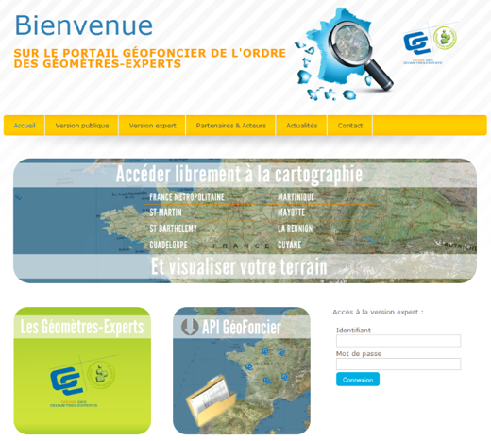
BACKGROUND
Thus, the development of a marine and coastline cadaster should contribute to legal security and anticipate the implementation
of the EU Directive.
The idea is to add coastal and marine data to the Geoland Portal
which was launched in 2010 by the OGE.

Slide 9
GEOLAND PORTAL
The Geoland portal enables to display a great number of geographical data with a great scale such as parcel plans, aerial photos, and environmental protected areas.
Cartographic data for the setting up of the portal for the Coastline and the Sea will be put on this portal.
The Geoland portal will therefore become a unique tool to display land, coastal and marine 3D data.
The Goeland portal applies to :

Slide 10
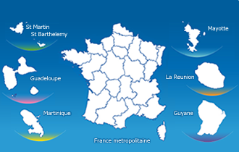
Portal For The Coastline and the Sea
France as a continent and Corsica | Guinea
Saint-Martin | Mayotte (French dep. Since 2011)
Saint-Bart’s | Réunion Island
Martinique | Guadeloupe

Slide 11
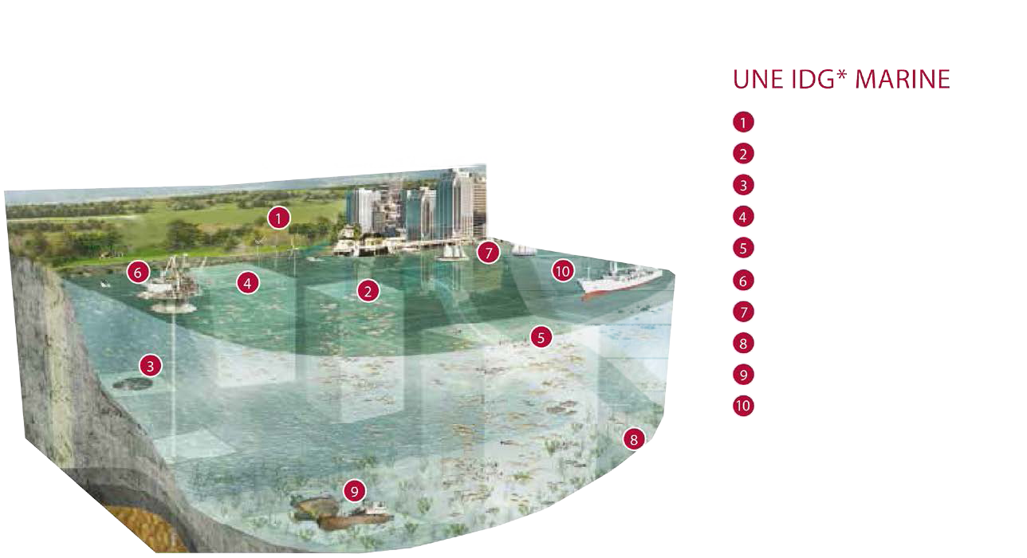
Portal For The Coastline and the Sea
Coastline
Marine protected area
Artificial reefs
Aquaculture
Fishery area
Offshore resources
Sailing area
Cables and pipelines
Heritage
Merchant marine
* Marine Infrastructure of Spatial Data

Slide 12
Portal For The Coastline and the Sea
CHALLENGES :
Be pragmatic in choosing uses and regulated areas to be considered.
Access to existing data (studies, GIS layers…) and their integration in the platform.
Convert regulations data into geographical georeferenced zones and make them consistent.
Develop specific functions for the Portal according to needs (flood simulator, 3D processing…).

Slide 13
Portal For The Coastline and the Sea
2 experimental areas were defined to test the feasibility of the Portal for the Coastline and the Sea :
  A first 40km area between Carry-le-Rouet and la Ciotat which will focus on the marine public area and the marine uses;
  A 2nd 4km area near the city of Sete which will focus on the coasts and the lagoons.
With these 2 zones the surveying profession wishes to have an in-depth reflection on the coastal knowledge and management (interface between sea and land) and to identify the uses and regulations on
the different marine areas.

Slide 14
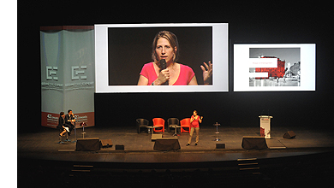

Slide 15
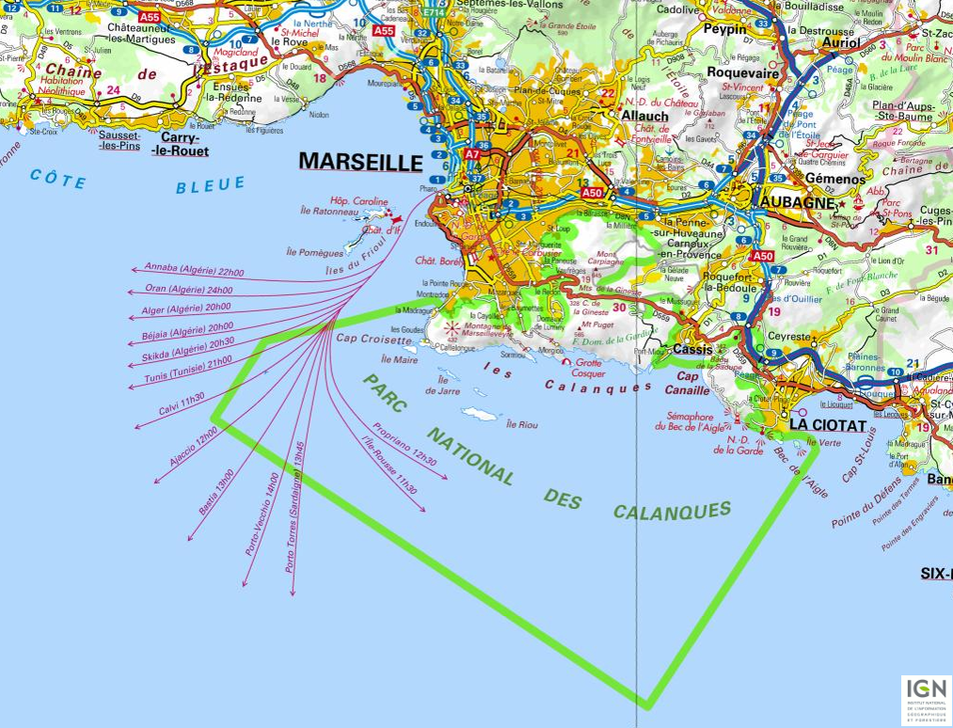

Slide 16
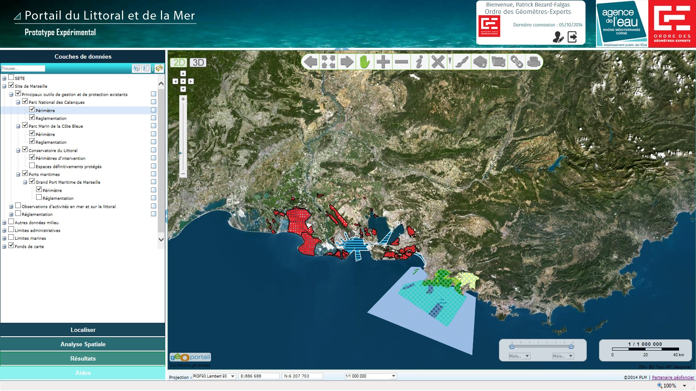
Portal For The Coastline and the Sea

Slide 17
Portal For The Coastline and the Sea
Marseille
Basic tools and maps
National parcs, uses and texts attached
Management Exemple : Conficts detection
Time is included : Evolution of the Coast Line

Slide 18
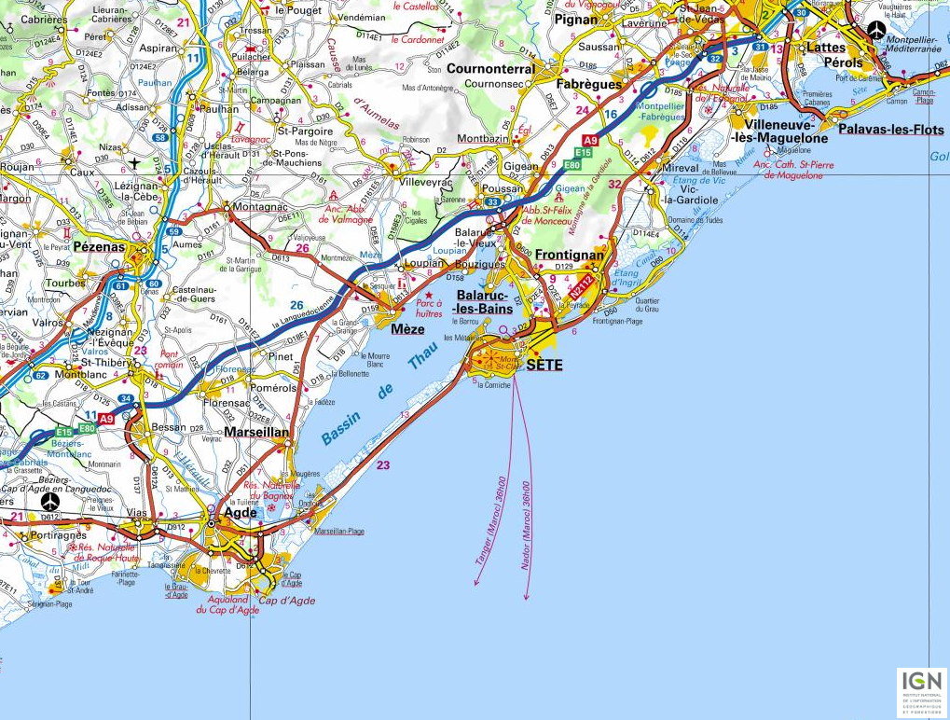

Slide 19
Portal For The Coastline and the Sea
Sète :
3D View : Clarifying public properties
Uses during one year
4th dimension : Time with Aerial photos
Risk Management

Slide 20
Portal For The Coastline and the Sea
PROJECT IMPLEMENTATION
1. Definition of the project objectives : identification of the stakeholders
2. Communication : collection of already available data
3. Tool development : data processing
4. Data integration : testing the tool with the stakeholders
5. Tool and data adaptation
6. Implementation : distribution

Slide 21
Thank you for your attention!

